Slide 1
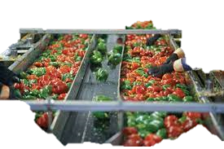
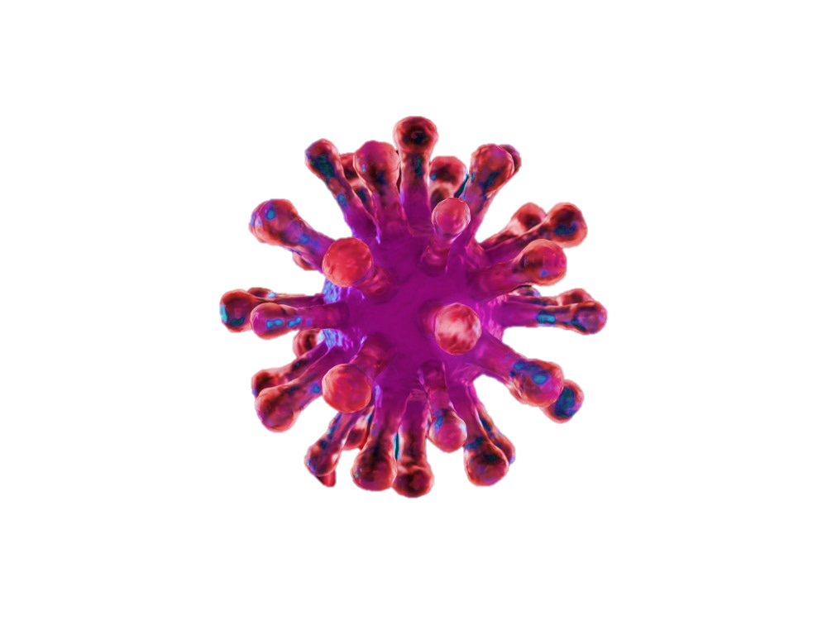
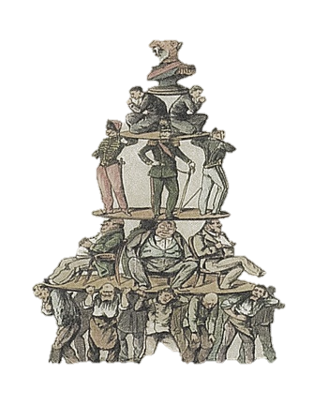

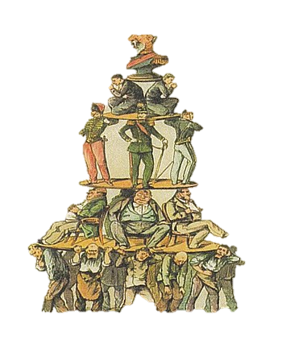
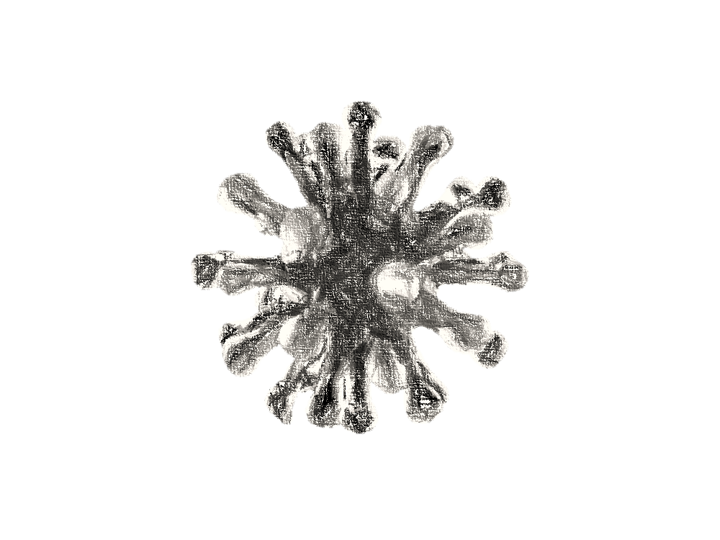
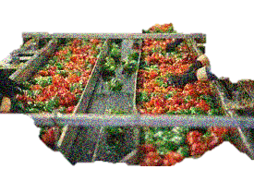
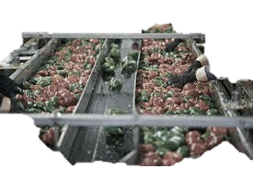
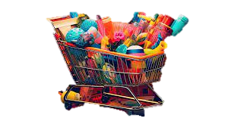
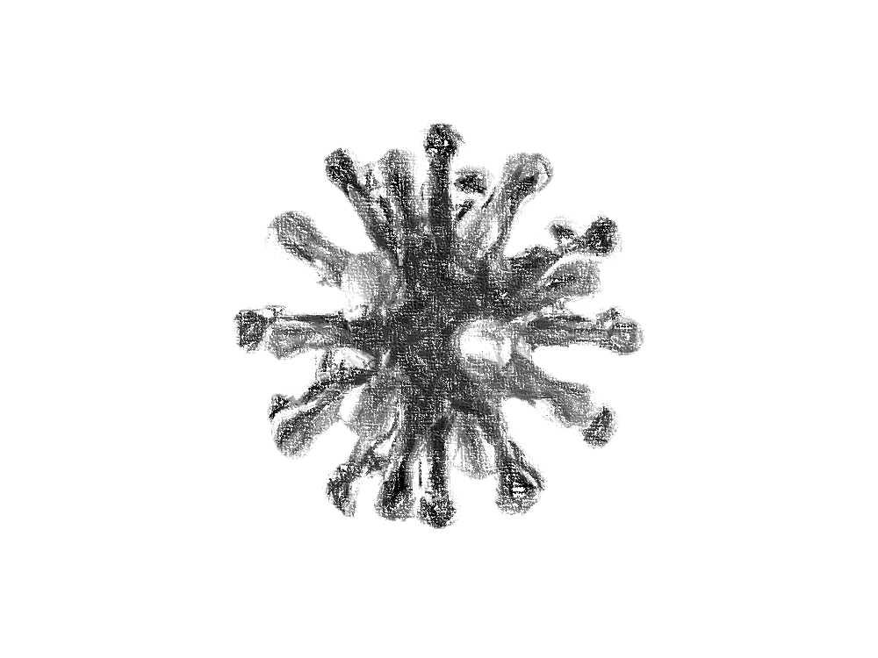
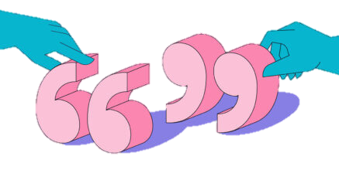
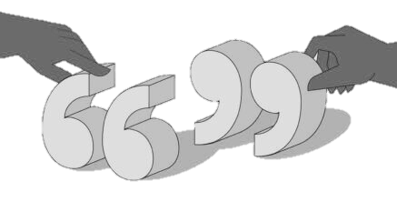
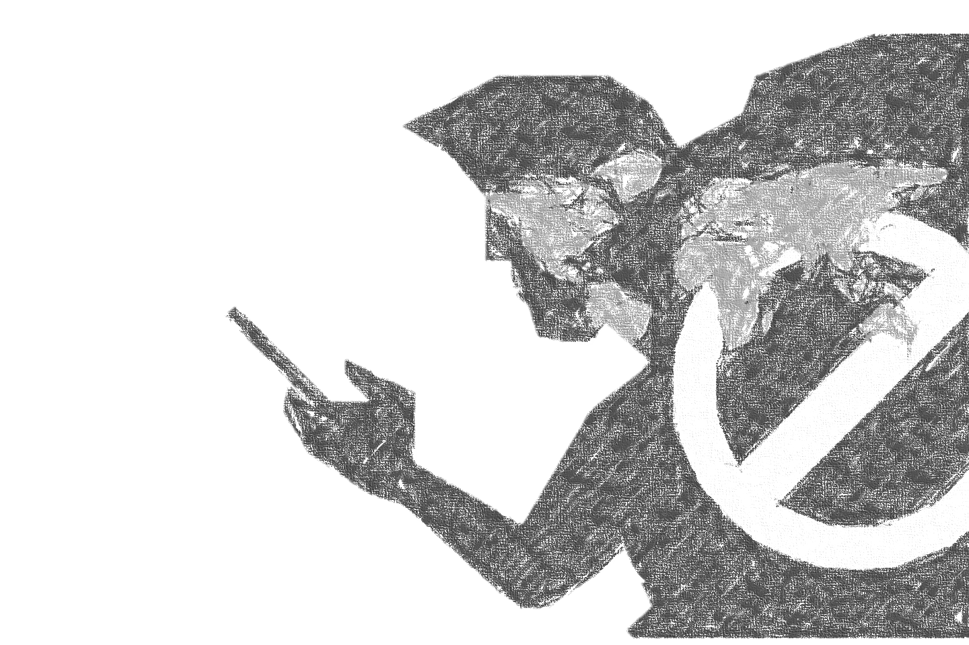

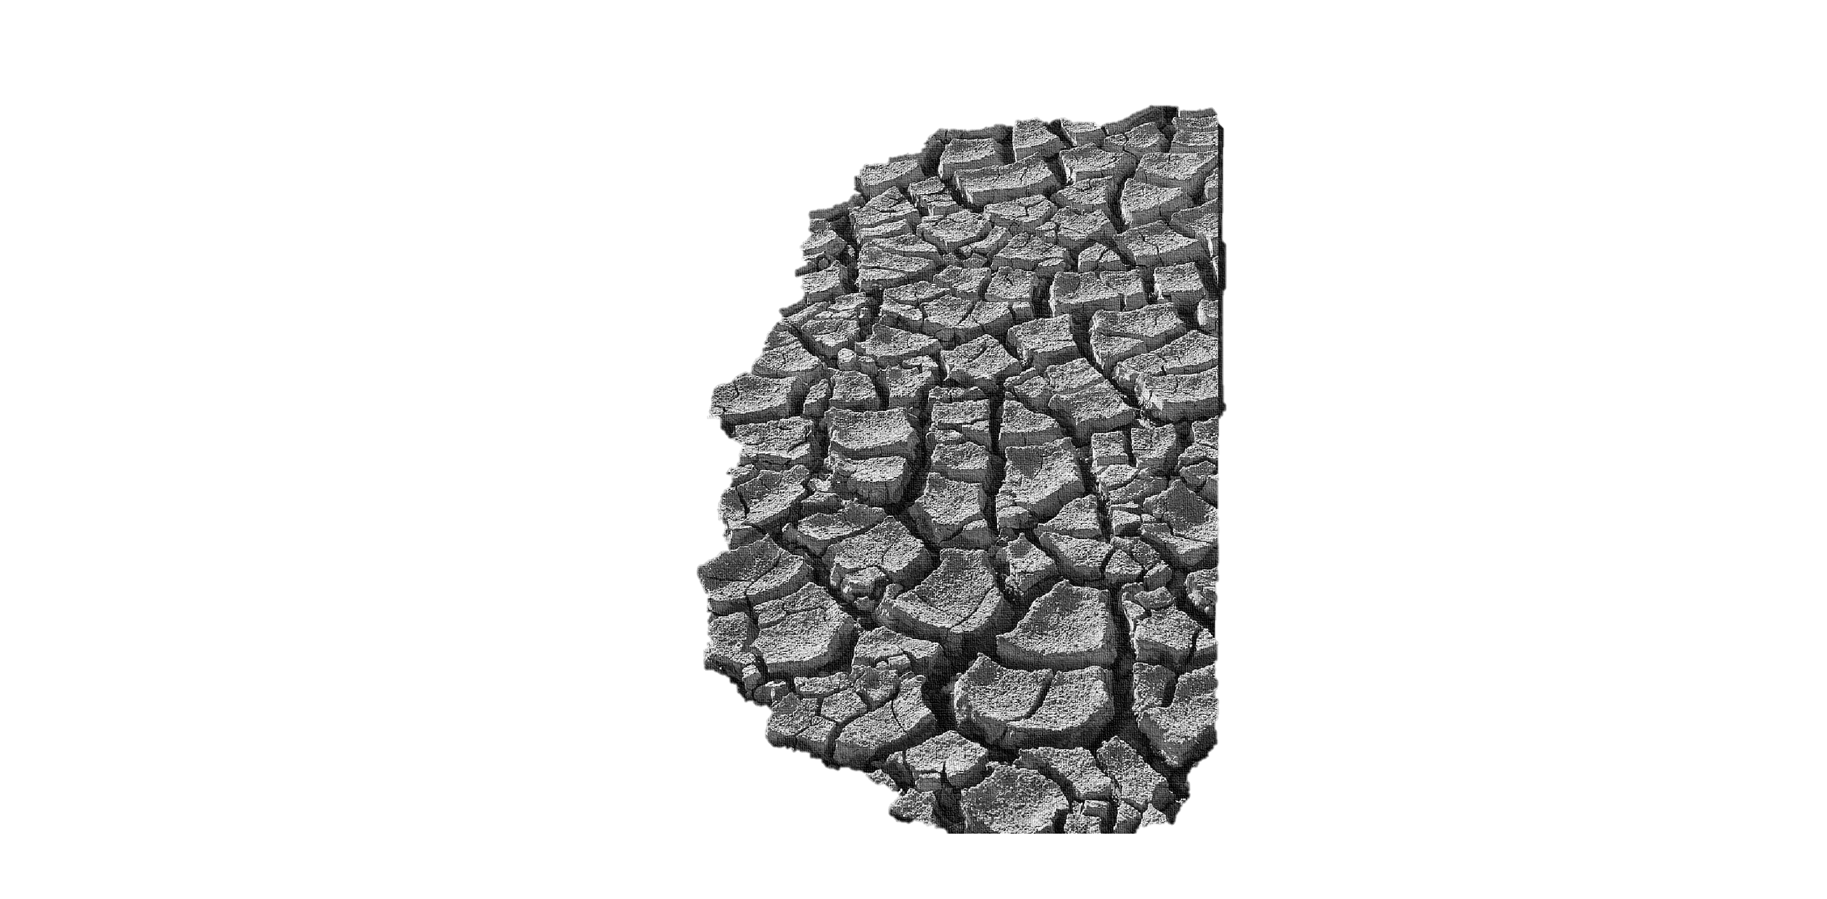
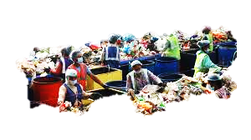

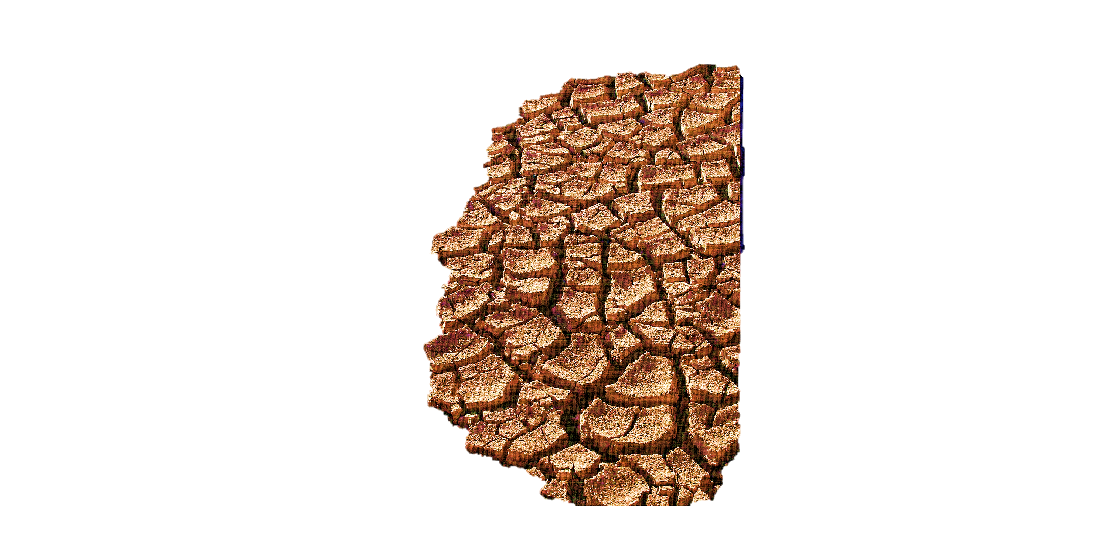
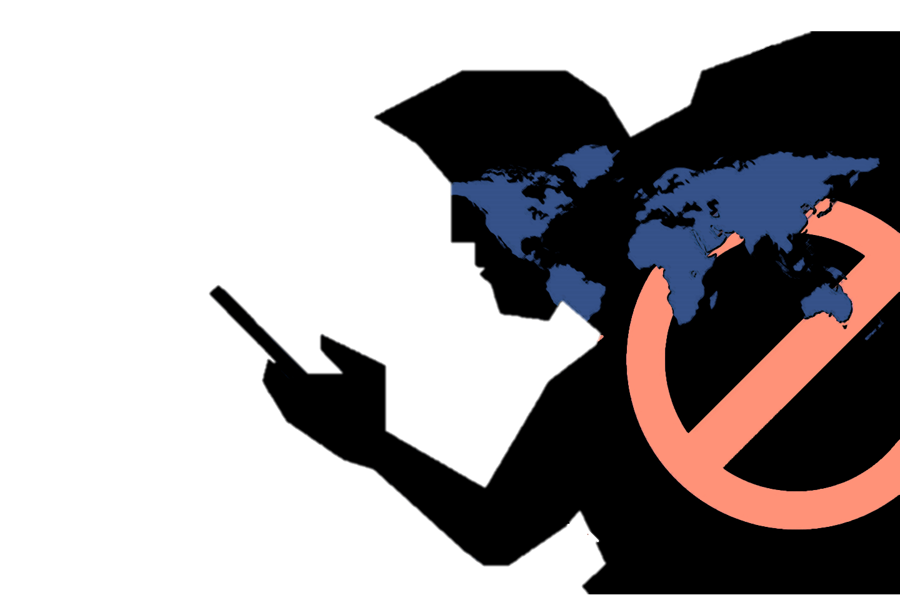

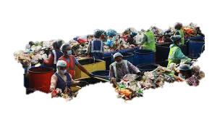

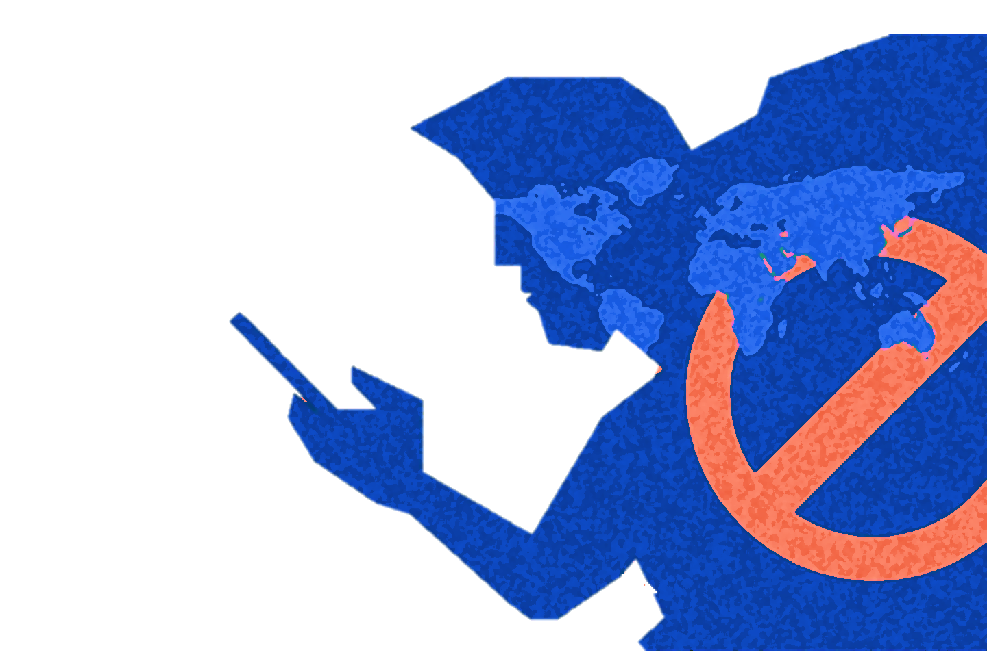


Issues That Instill Fear
Creating a Mythical Creature Catering to Modern Society

Slide 2
Auto Immune Diseases
How can you battle sickness when your body is against you?

Slide 3
Auto Immune Diseases
Occur when the immune system confuses healthy cells for infected ones in the body and attacks them
The cause for the immune system to act this way is unknown
As the immune system is the primary self-defense mechanism of the body, it is only natural that fear emerges when it goes awry

Slide 4
The immune system works by identifying infected cells with pattern recognition molecules. It then triggers the lymphatic system which generates proteins (known as antibodies) to counter and attack those protiens (known as antigens) of the invading cell. It is in this identifying process that something goes amiss, and the body ends up sending it’s defenders to attack healthy cells. This a very basic explanation of how auto immune diseases occur, excluding the medical terminology.
This fear is perhaps more personal to me than the other nine on this list, as I have a parent who struggles with an auto immune disease. Living takes on a different meaning, and in turn – so does loss. Fear thrives in uncertainty, and thus looms overhead when every day becomes a battle between the mind and body.

Slide 5
Climate Change
The end of the world, according to some.

Slide 6
Climate Change
.
Poses as an umbrella term for many environmental concerns
Though there is progress in battling global warming, many fear it is too slow
General awareness regarding this issue is also lacking
The implications of climate change proves to be a cause of great concern, even if one may not feel it in their day-today.

Slide 7
Various forms of pollution and deforestation top the list of environmental concerns. All these concerns add up to what we call climate change, and though its consequences may not affect our living conditions at this moment, they are for sure to snowball into something unmanageable if not handled properly.
This is a classic case wherein even a small action can lead to a intensly large reaction. Therefore, every effort that is taken in controlling the damage we are unleashing upon not only ourselves, but every eco-system that co-exists with us on earth, is important.
Climate Change regards conversations that contemplate the end of the world, and if that does not strike fear, I’m not sure what will.

Slide 8
Cyber Security
How much of our digital lives is actually private?

Slide 9
Cyber Security
As the world moves into a significantly digital way of living, a fresh set of issues arise
Problems regarding online privacy perhaps top the growing list
The fear of identity theft, impersonation and other such cyber crimes have become prevalent.

Slide 10
I will use an example to highlight this issue, and that example shall be Google. Today, the word Google may as well be a verb in the dictionary, considering the amount of time one uses it on a daily basis. Slowly, it has become our everything – woven in the way we communicate with one another and the world digitally, the way we gather and glean information, the way we prefer our entertainment, and practically how we live.
With that much data in the hands of a single entity, it becomes a matter of identity theft if it is misused. Exactly how much data you may ask? Google’s ad preferences feature will let you know. There are many conspiracies regarding Google’s privacy issues; some say that users’ information is being sold to corporate organizations while others claim that security on said information is poor, leaving hackers plenty to work with.
Many also ask why privacy is an issue when one has nothing to hide. Information can be manipulated and used against anybody in any situation; pictures, digital trails, conversations – the possibilities are endless. As society progresses it is actively becoming difficult to avoid the use of gadgets and digital appliances. With the advent of AI, the seemingly endless possibilities become definitely endless.

Slide 11
Waste Management
This unseen reality is perhaps causing more damage than we are made to think.

Slide 12
Waste Management
Waste management, or rather lack there of, is a root cause of major environmental damage.
The improper handling of waste that is generated by humanity is leading to the deterioration of many ocean ecosystems, as well as causing harm to millions of animal life.
Once again it is the ease in which how easy it is to ignore the causes and effects of these devastating changes that is truly terrifying.

Slide 13
The amount of waste humanity generates is on the scale of billions, if calculated in kgs per day. A single human is said to produce around two kilograms of waste per day. That may not seem like very much, but that two kgs may contain wastes of varying toxicity, such as e-waste or medical waste on one end, to paper and plastic waste on the other. The manner in which these wastes affect the environment if not disposed of correctly will be the same, differing only in matters of how directly and how speedily.
Waste management begins in every home. But where does it end up? Images of landfills, “islands of garbage” in the sea, and more locally, plastic bags strewn across the street are not unfamiliar. Short term, they probably cause an influx of disgust. Long term effects prophesize the end of many smaller universes within ours. As this issue is under the umberella term of climate change which was previously discussed, many of those terms operate here as well, such us the butterfly effect.

Slide 14
Misinformation
In the age of social media, the lines between true and false are constantly blurred.

Slide 15
Misinformation
Globalization, aided thoroughly by the rise of the internet, naturally comes with its pros and cons.
When knowledge is literally always just a click away, the information available across the net is hard to verify.
Misinformation can be dangerous in many ways, armed with the misunderstandings it can cause.

Slide 16
Misinformation has always been a problem; the media has a history of manipulating facts and disregarding truth, but now this issue has developed from a more local setting to a global one. In an age where money can be transferred online and petitions signed with just a click, it isn’t very difficult to end up providing resources and supporting a cause that is misrepresented. When democracies govern some of the most powerful nations in the world, the opinion of the masses is very much important, and it is in this world view that misinformation becomes threatening.

Slide 17
Rejection
In terms of competitive exams, sometimes every mark decides the kind of life you will lead.

Slide 18
Rejection
The competitive exam cycles, especially in India, are unforgivingly ruthless, due to the size of the population.
Hard work doesn’t guarantee success, and for those who do not have the choice of a different path, it can make or break their life.
The fear of rejection in this case becomes very real.

Slide 19
Plagiarism
As technology develops and AI integrates into our day to day, originality is hard to discern.

Slide 20
Plagiarism
Even Before the advent of AI, copy pasting information wasn’t uncommon.
Plagiarism ranges from high school student projects to stealing whole livelihoods (in terms of music, art, business ideas, research papers etc.).
It would certainly be a nightmare if someone else reaps the benefits of something you put your soul into.

Slide 21
Food Processing
What really goes into what we eat everyday?

Slide 22
Food Processing
There is a lot that is not revealed in the way that the vegetables and fruits which make up our daily diet is processed
When preservatives, chemical fertilizers and various other scientifically gray areas dominate the manufacture of food, what exactly is safe to eat and what is not?
Since eating is how we gain the energy to do everything we do, its frighting to learn the extent to which we don’t have control over our health.

Slide 23
Consumerism
Media, marketing and mob mentality – perhaps also an economic extravaganza.

Slide 24
Consumerism
c
This theory questions the boundary of needs and wants, and in its extreme forms damages the environment drastically.
In the short term, it may be seen as good for the economy and providing opportunity, but it is closely linked with the excessive generation and mismanagement of waste.
Again, the implications of the long term consequences of this phenomenon is perhaps more frightening than what we see in our day-to-day.

Slide 25
Social Stratification
Casteism, Classism and other forms of discrimination based on an intensly fla

Slide 26
Social Stratification
This structure in most human societies still continues to haunt the lives of the present.
Discrimination based on social standing, caste or class is still very much a part of Indian society, and the extent of its effect on the day-to-day lives range from mistreatment and stolen opportunities, to abuse and in some cases, even death.
There’s a long way to go in terms of overcoming this issue, and until then, fear will hold the hearts of many.

Slide 27
In Conclusion
Auto Immune Diseases
Climate Change
Cyber Security
Waste Management
Misinformation
Rejection
Plagiarism
Food Processing
Consumerism
Social Stratification

Slide 28
Thank You.

